Slide 1
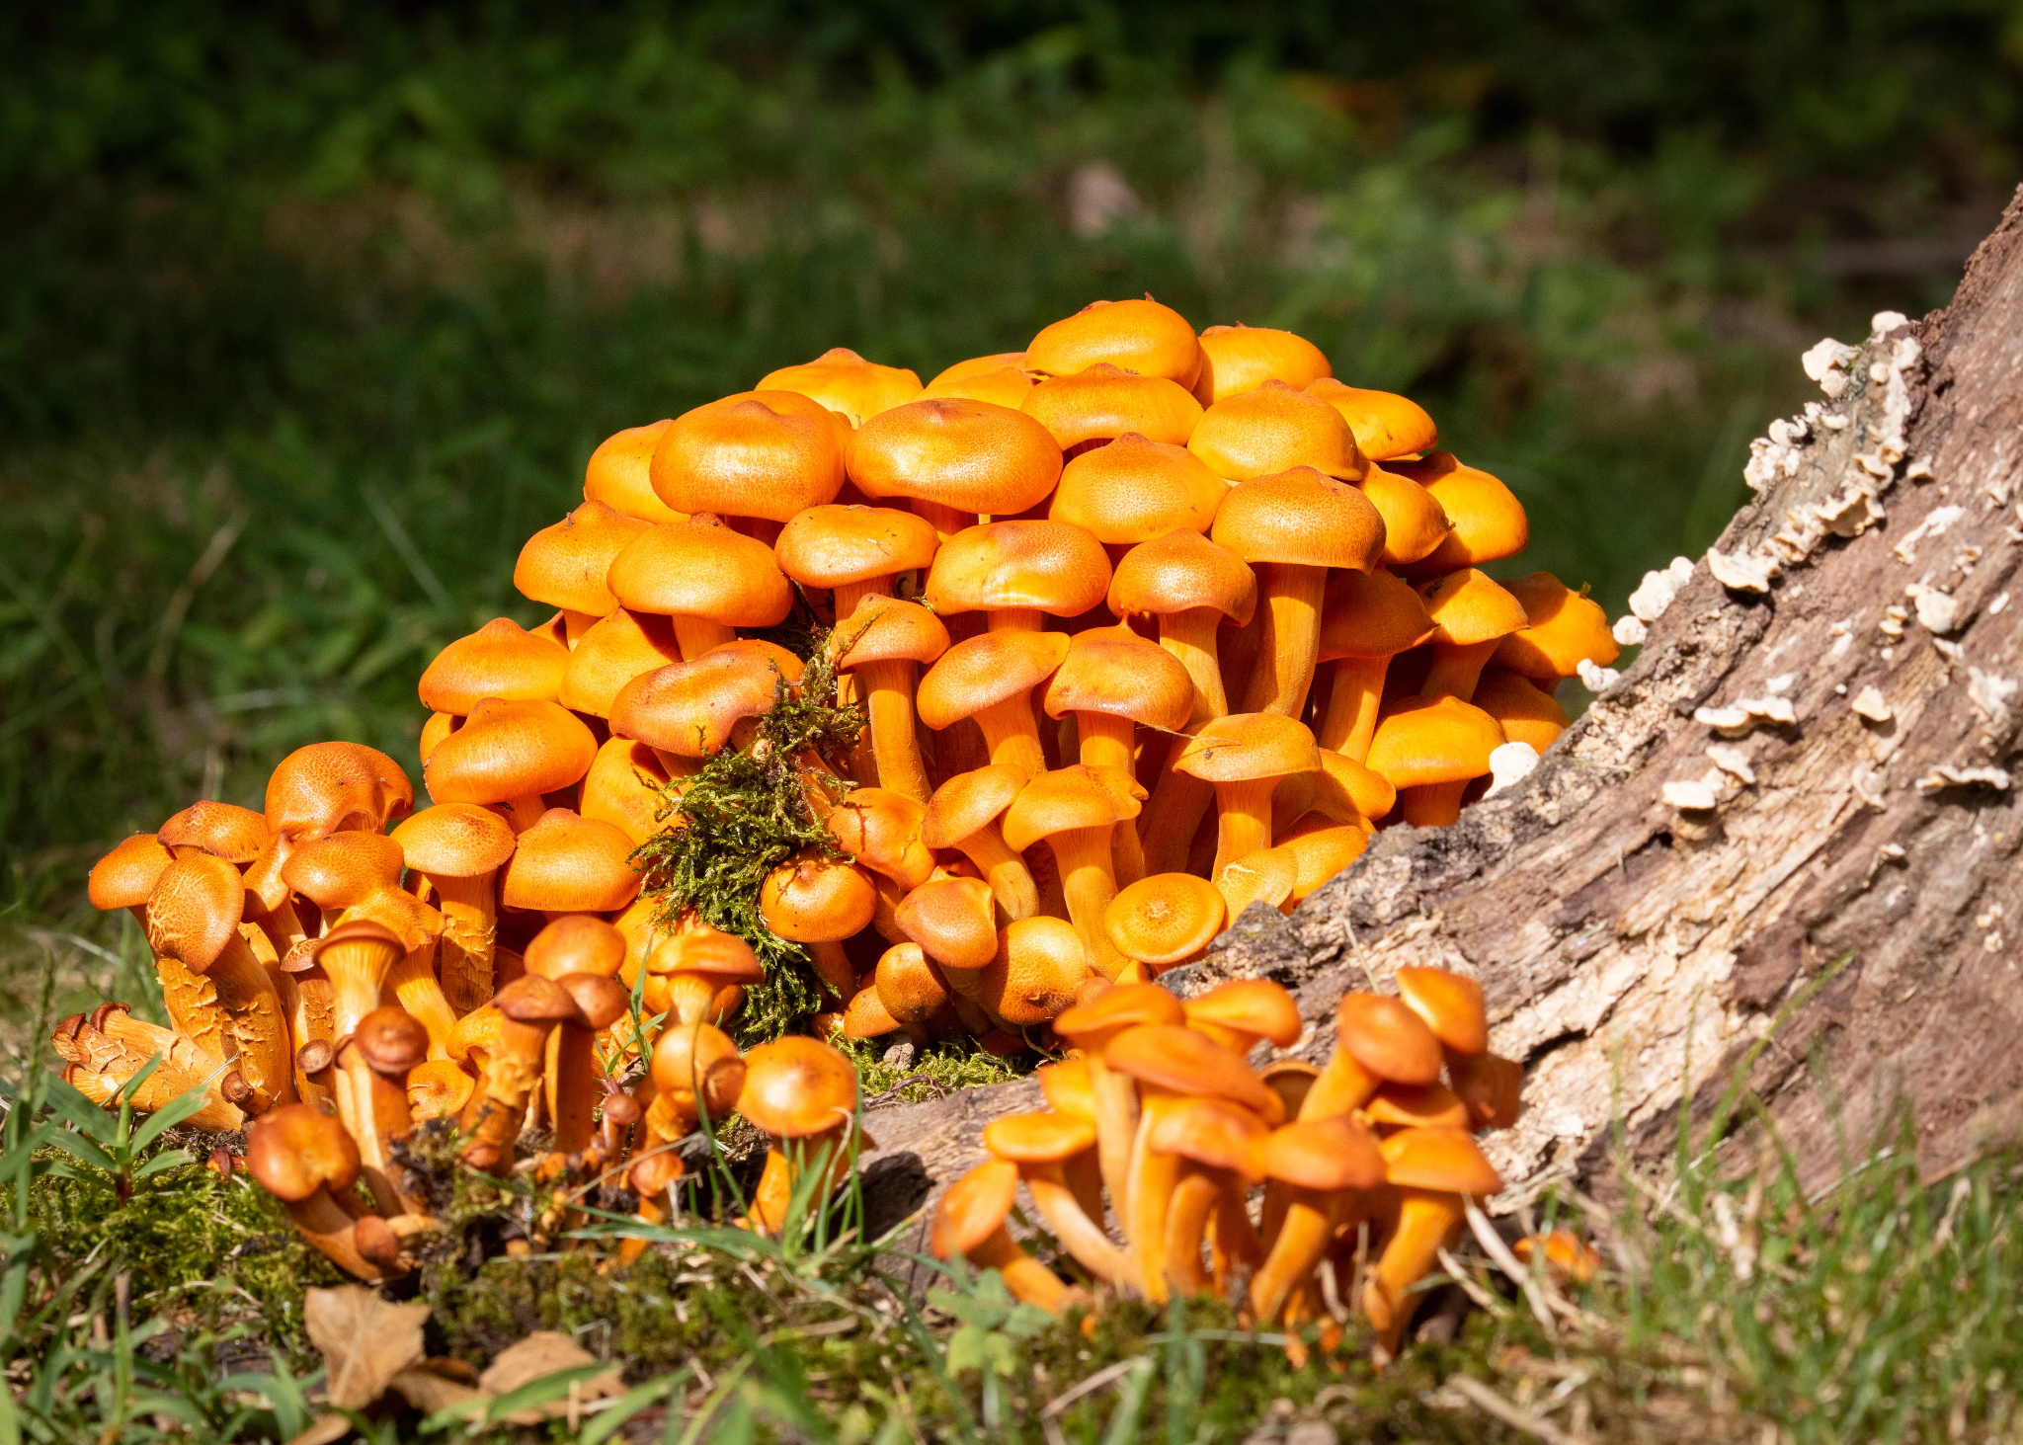
Mushroom Classification Using Different Classifiers
Introduction To Machine Learning Final Project
Cigdem Akdemir

Slide 2
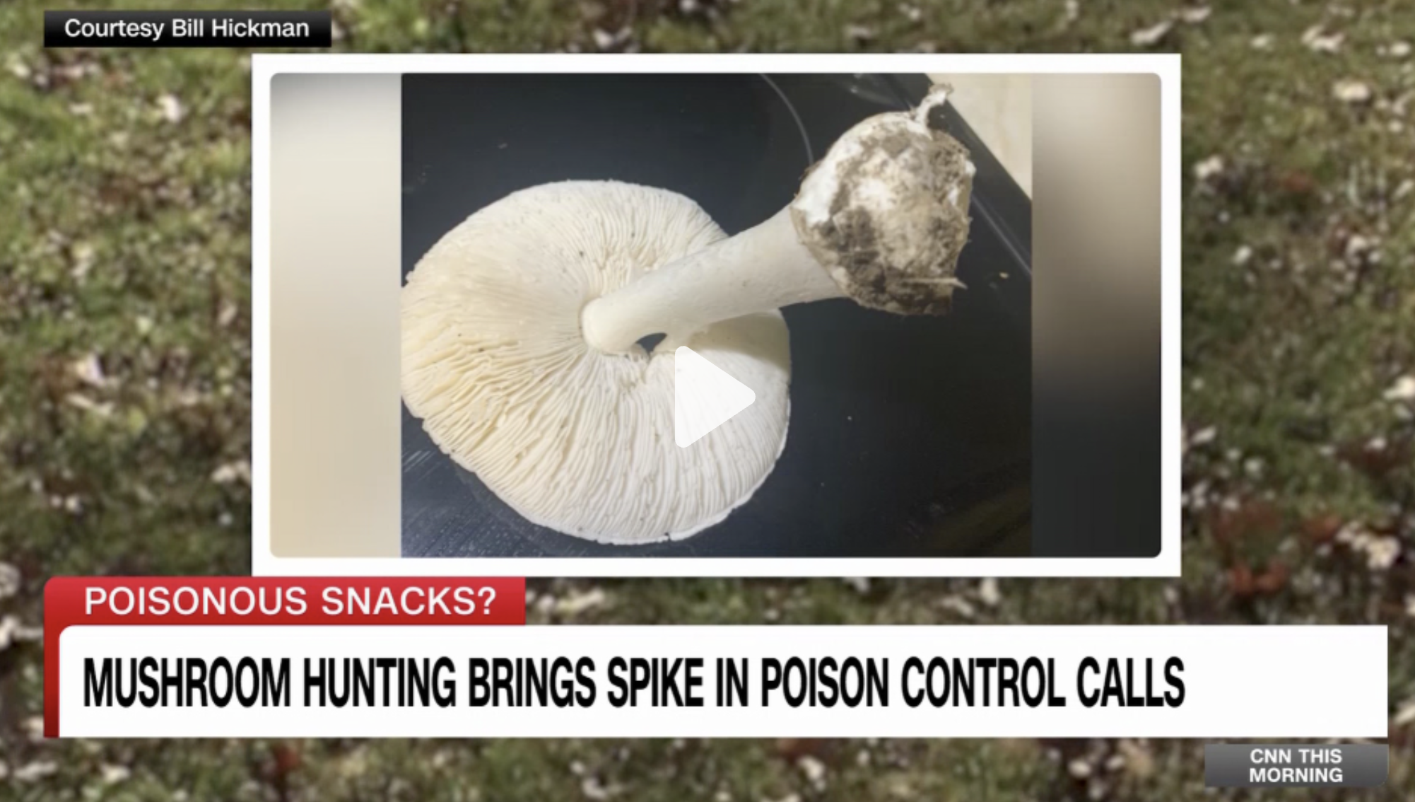
In this news ;
Mistook a poisonous mushroom for an edible one.
Needed emergency treatment and an experimental antidote to survive.
Importance of Mushroom Identification
Mushroom foraging is popular but risky.
Many poisonings happen due to wrong identification.

Slide 3
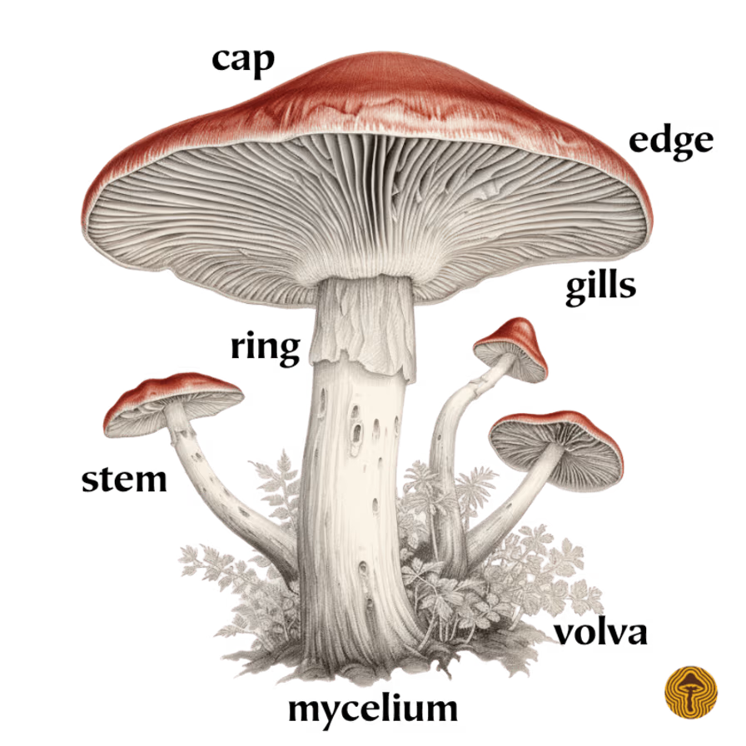
1-Introduction
There are over 50,000 species of mushrooms only in North America
Poisonous mushrooms can be hard to identify in the wild!
In this project, I will analyze the data whether a mushroom is edible or poisonous based on its characteristics, such as cap shape, cap color, gill color, and more, using different classifiers

Slide 4
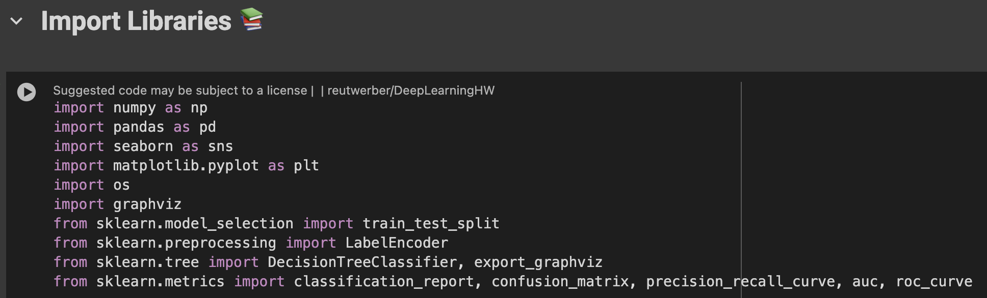
2. Importing the Python Libraries and Packages

Slide 5
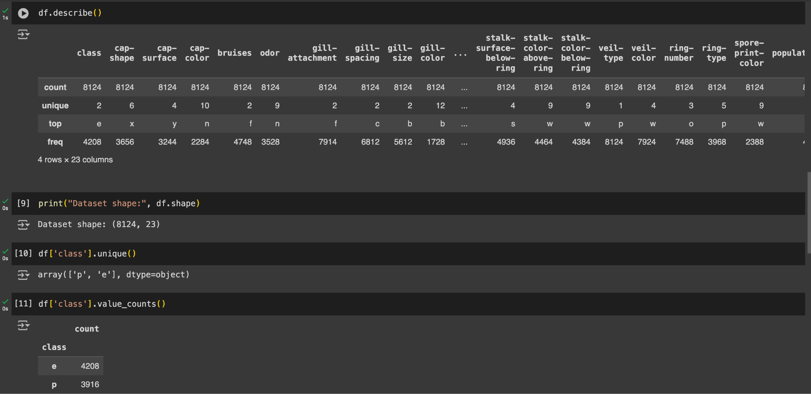
3-Data Analysis
E: edible p: poison

Slide 6
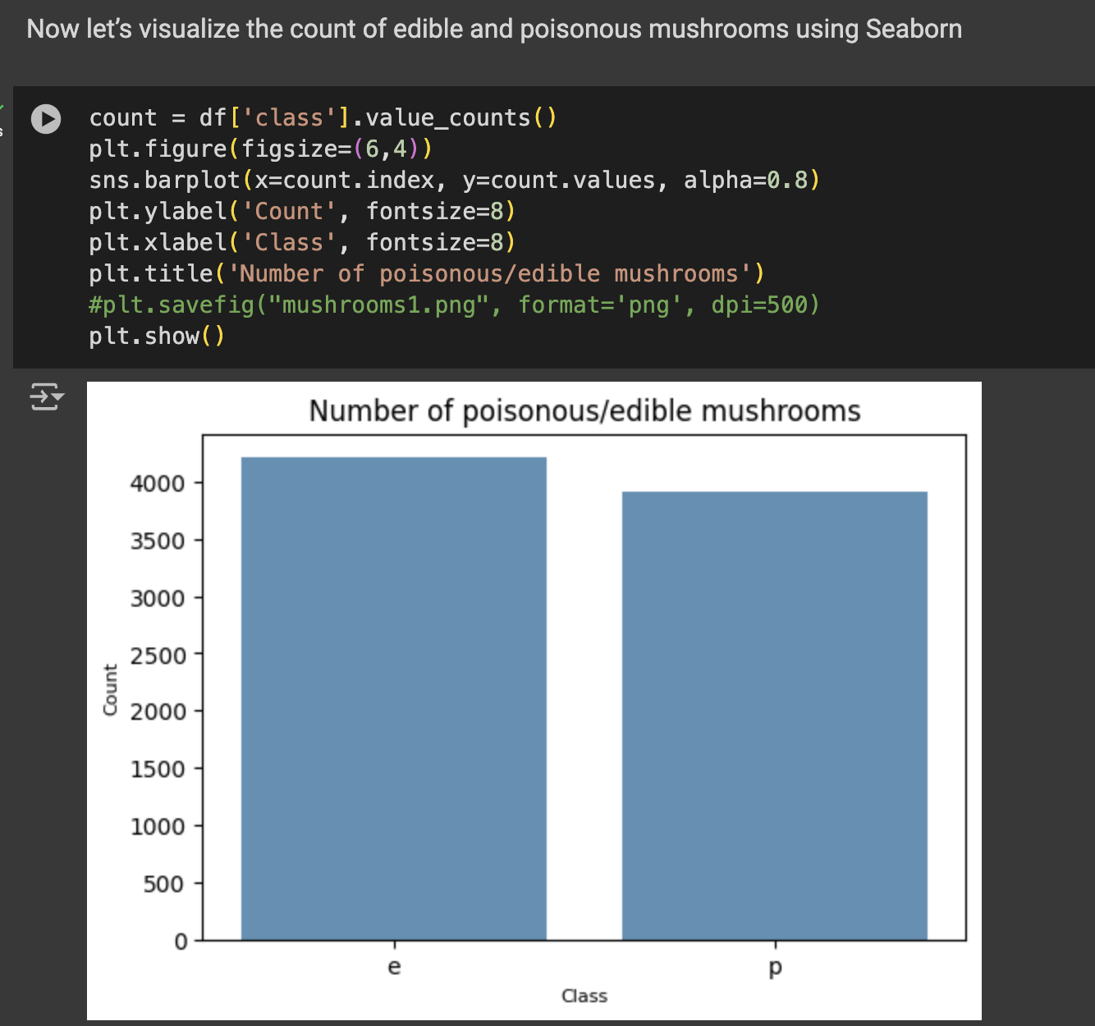
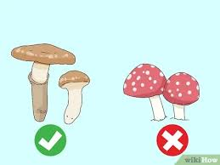
From the bar plot we see that the dataset is balanced.
Library : Seaborn

Slide 7
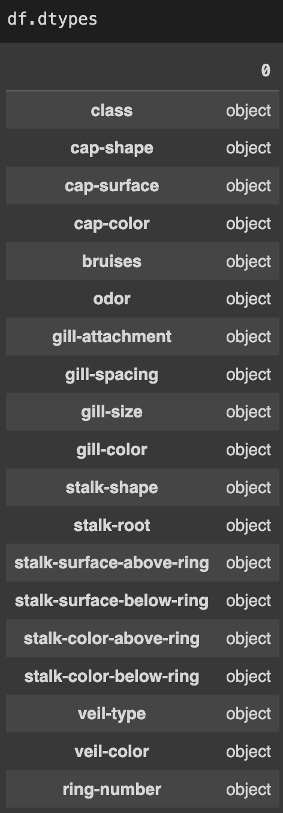
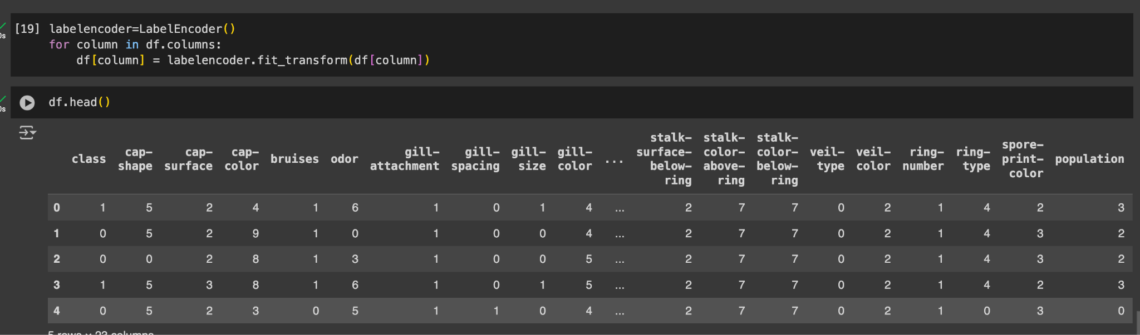
4- Data Manipulation
As we can see, our columns are now of type ‘category’. We can now use LabelEncoder to convert categorical values to integer.

Slide 8
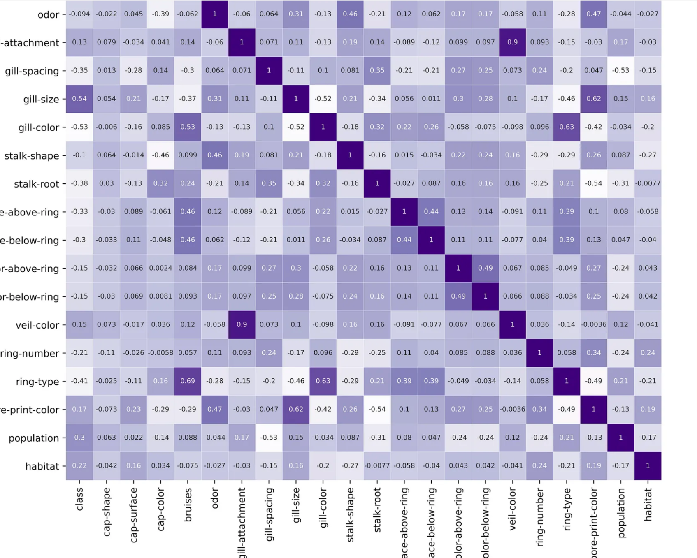
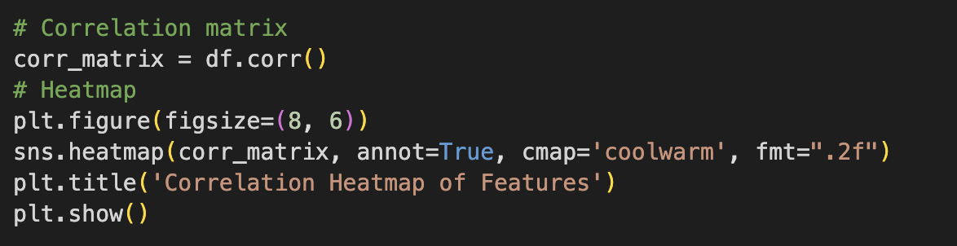
Let’s look at the correlation matrix
Usually, the least correlating variable is the most important one for classification. In this case, “gill-color” is -0.53 so let’s look at it closely

Slide 9
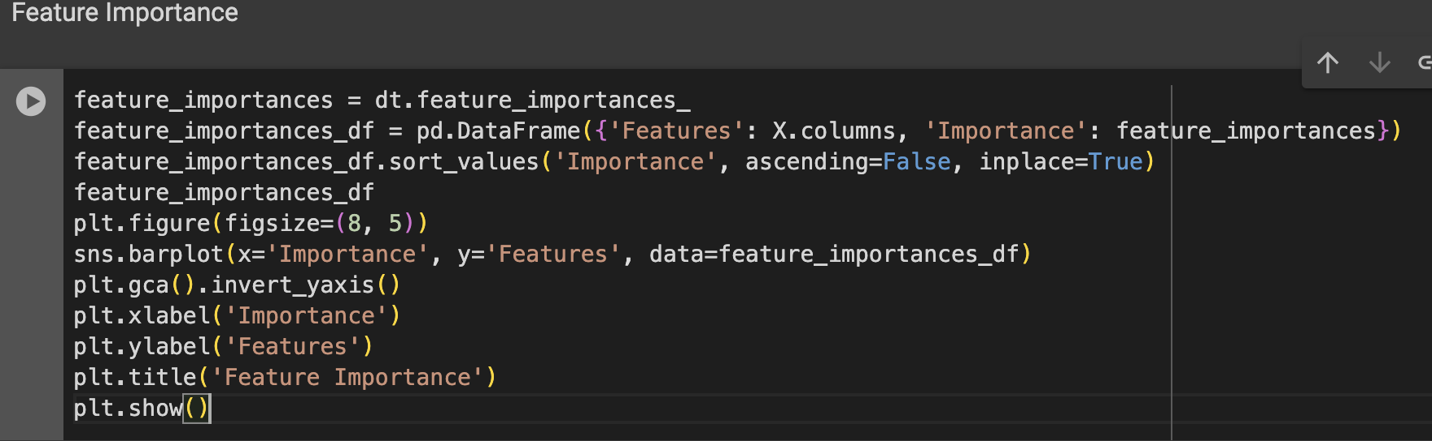
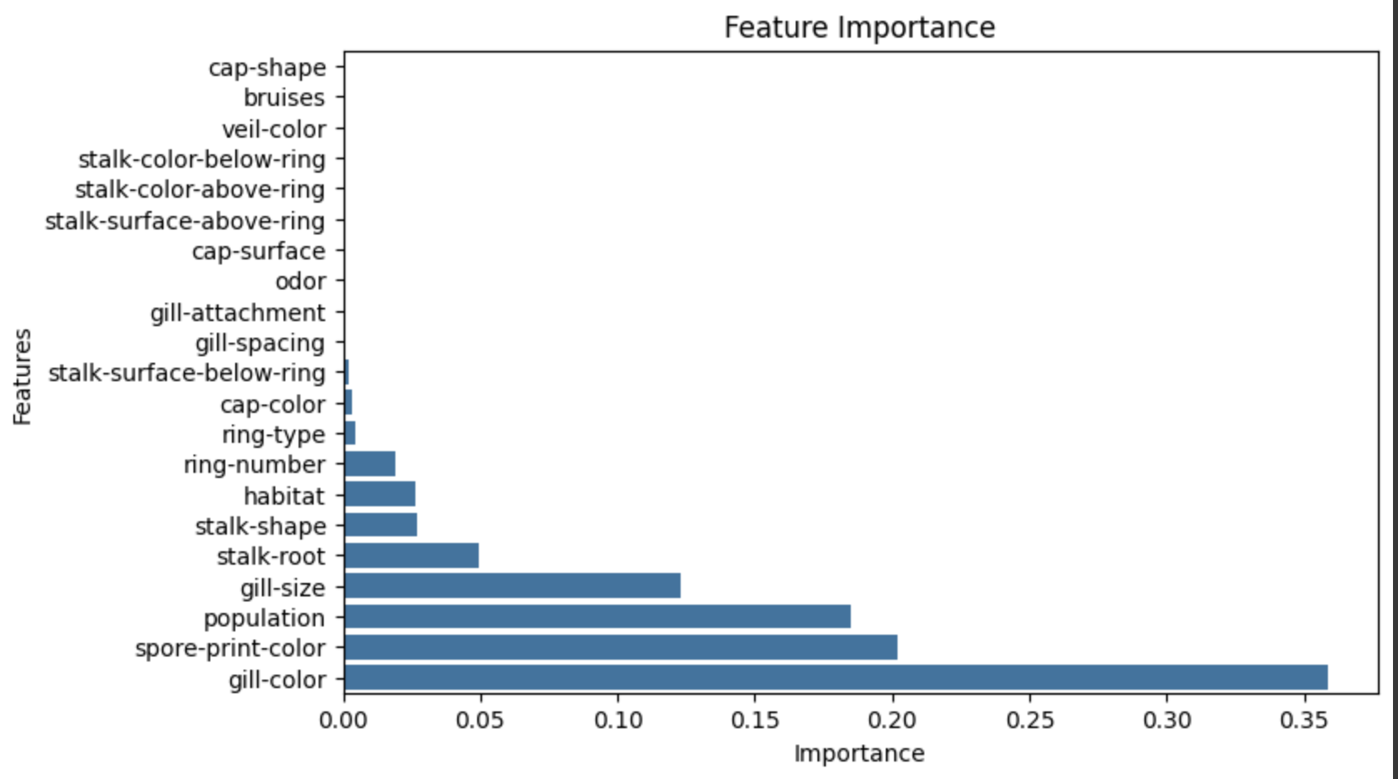

Slide 10
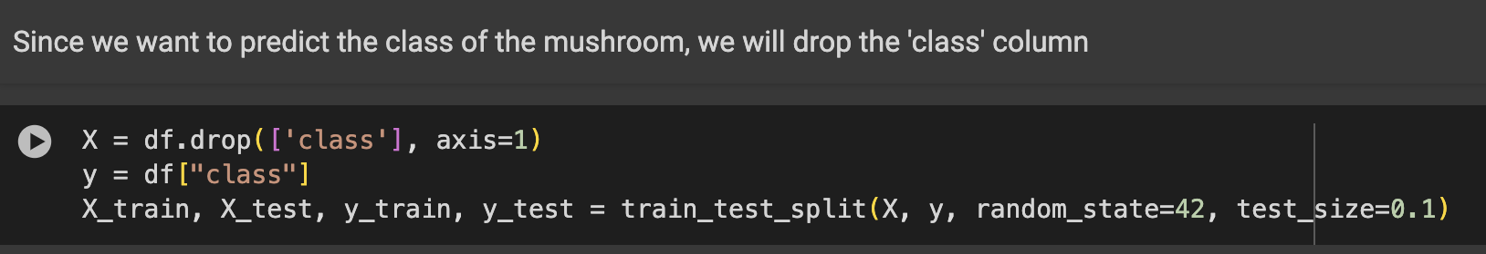
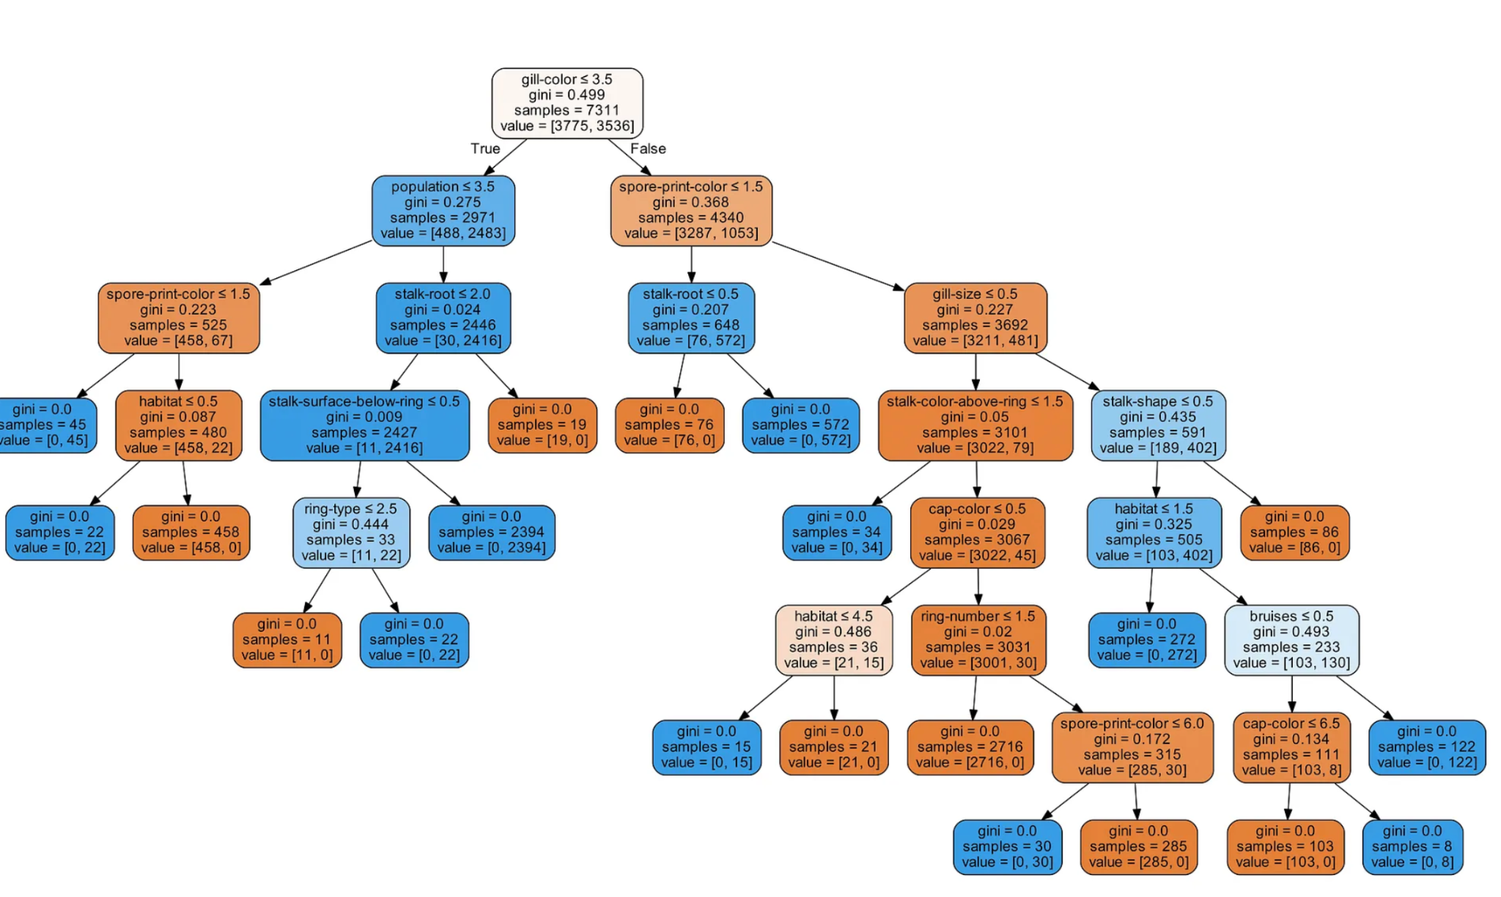
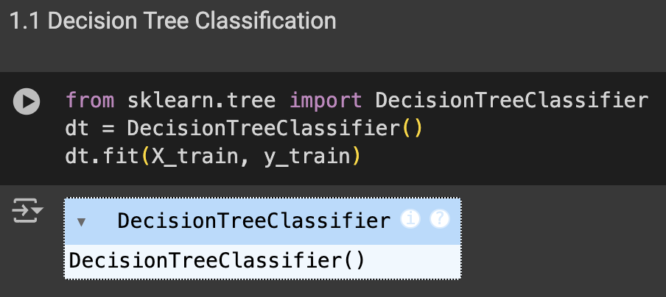
5-Preparing the Data
6- Classification Models

Slide 11
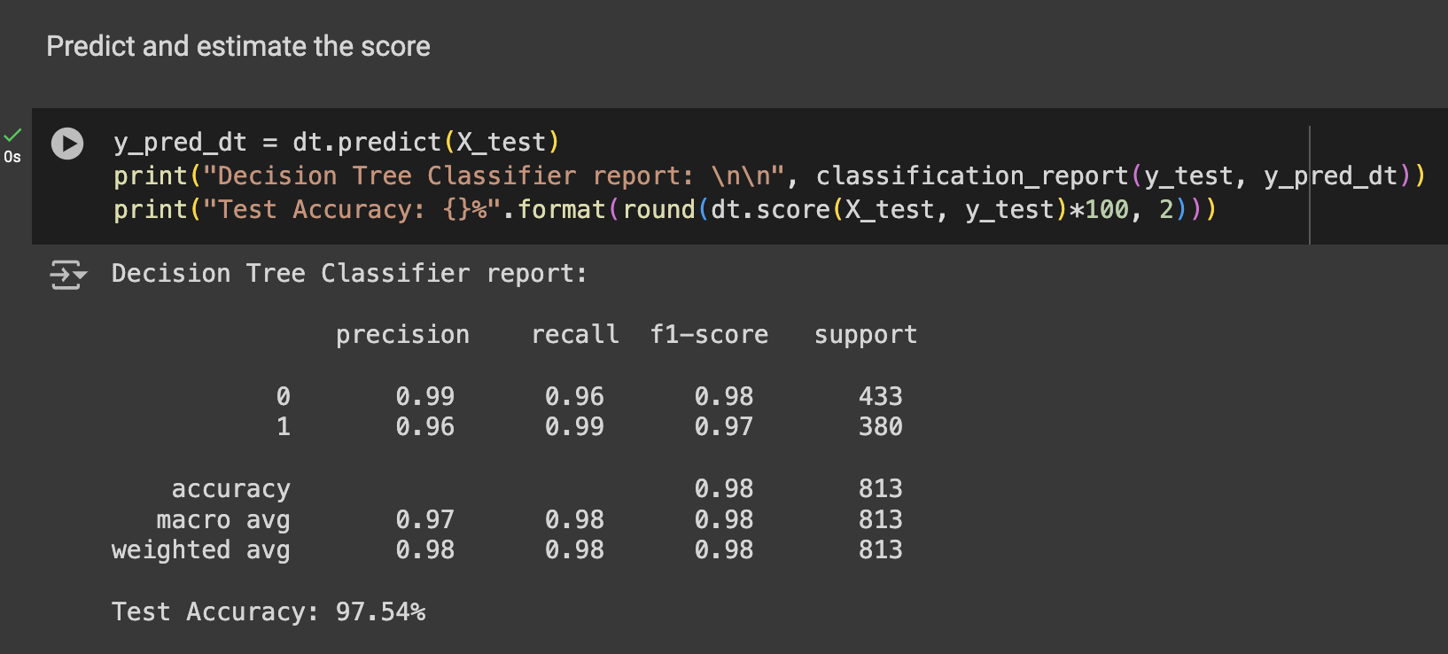
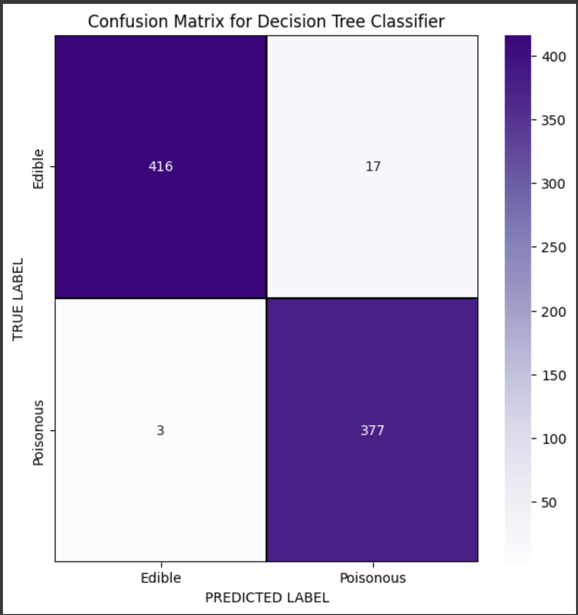
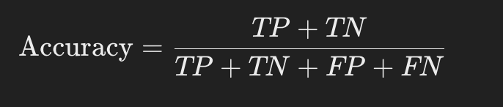
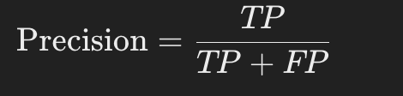
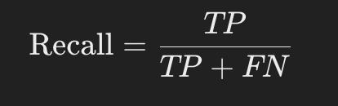

TN
FP
FN
TP

Slide 12
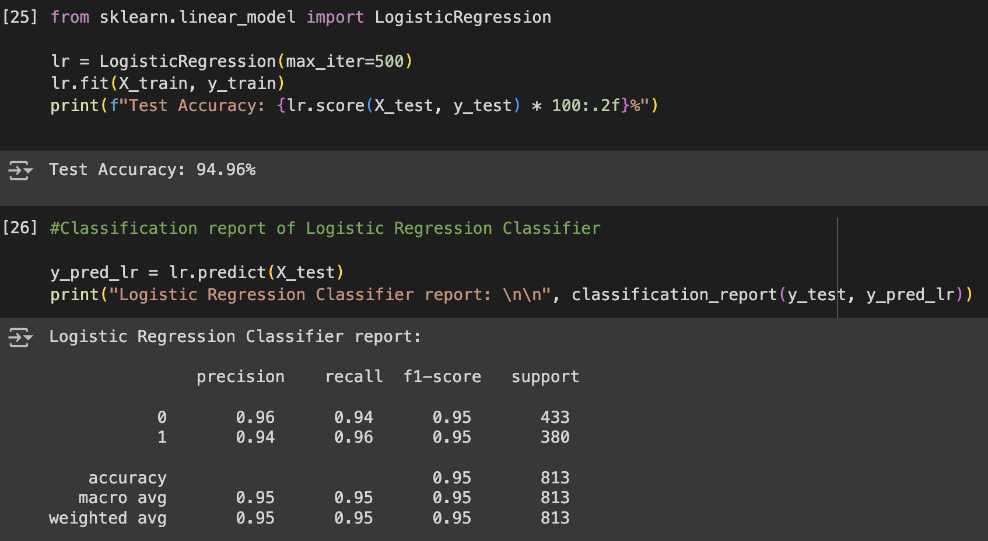
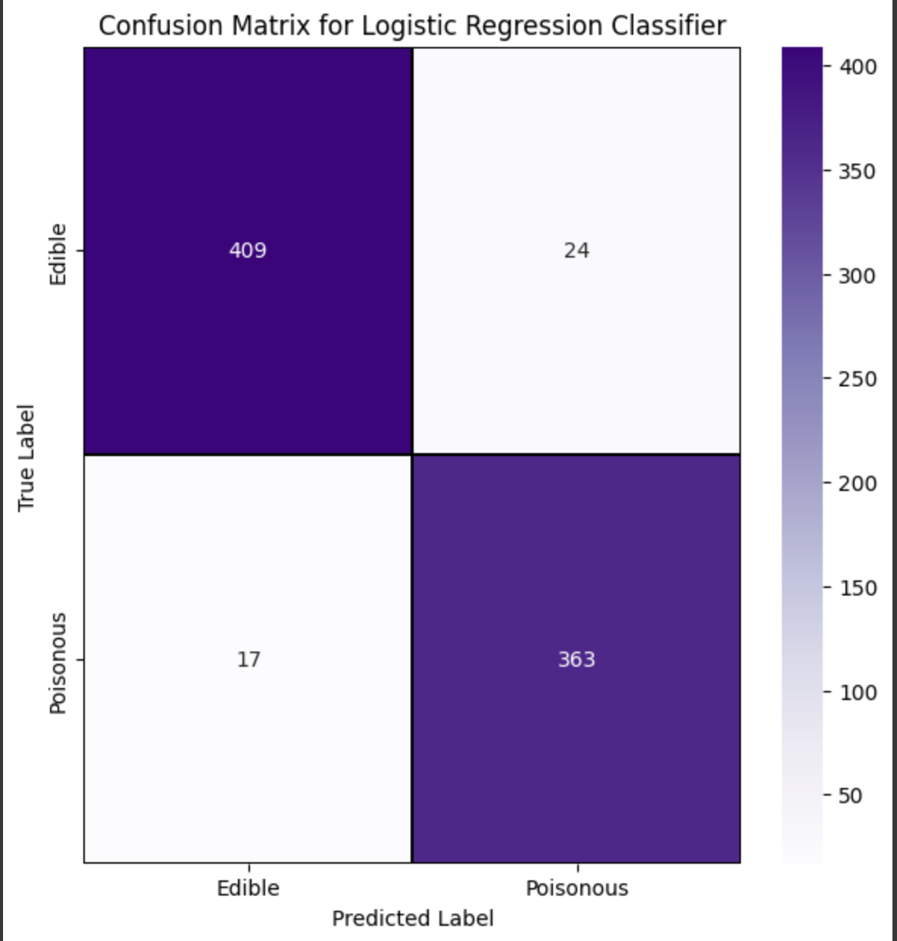
6.2.Logistic Regression

Slide 13
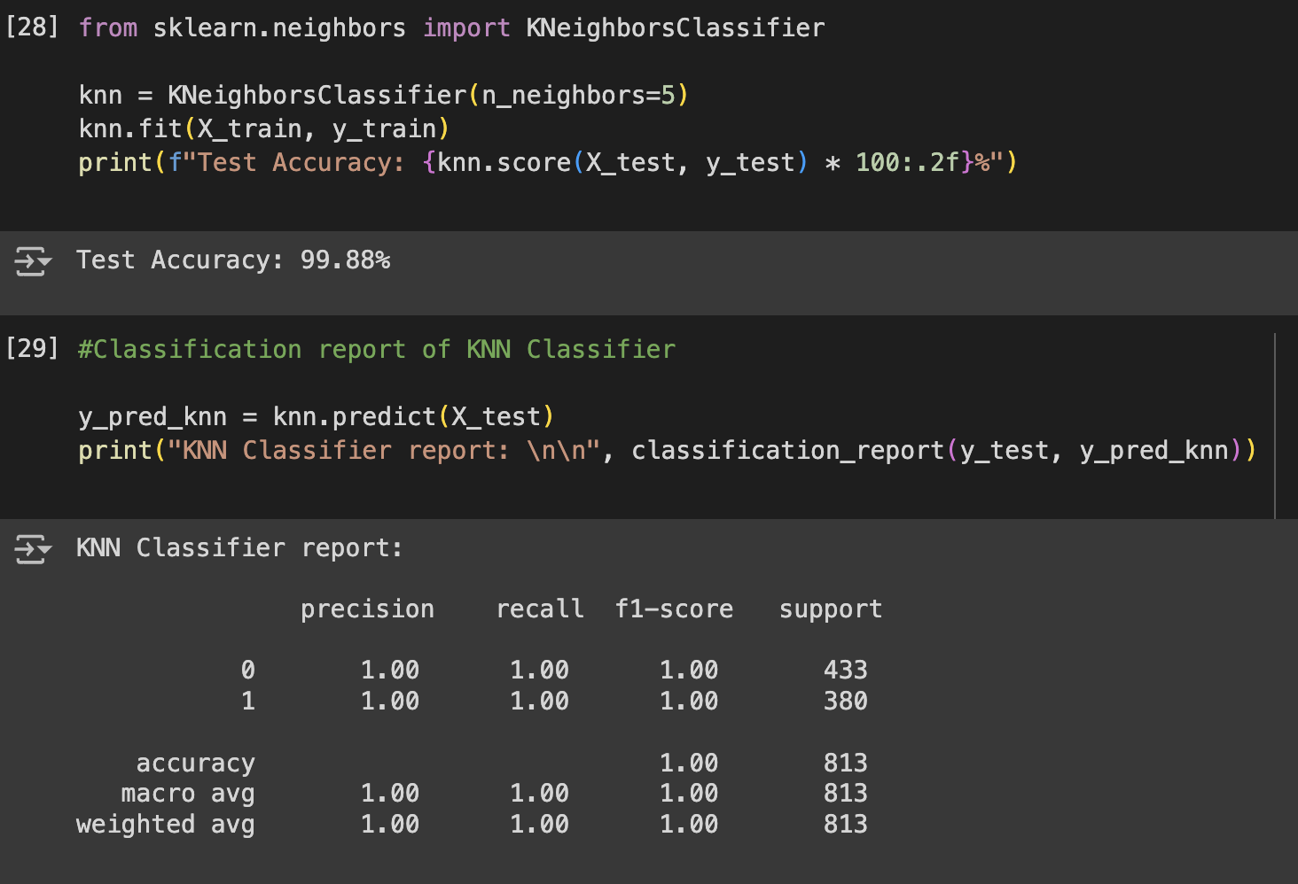
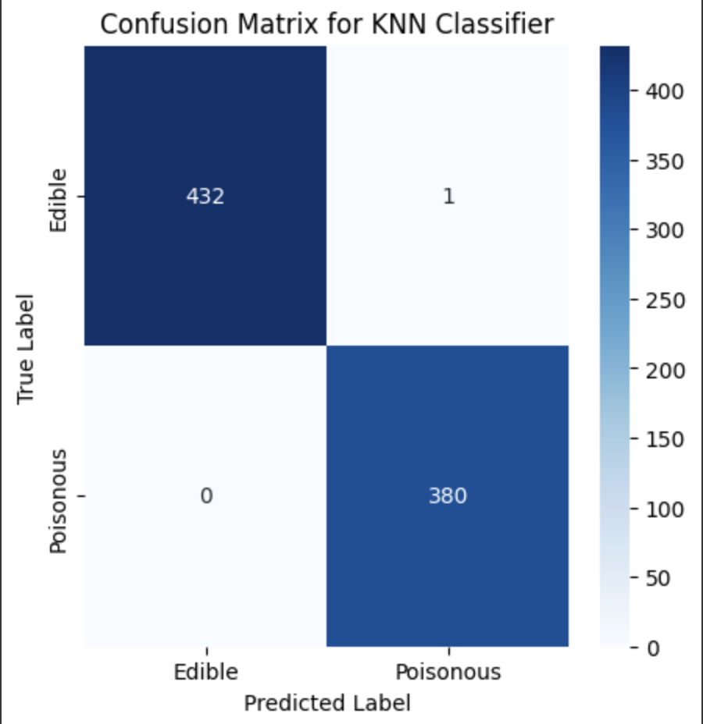
6.3.KNN Classification

Slide 14
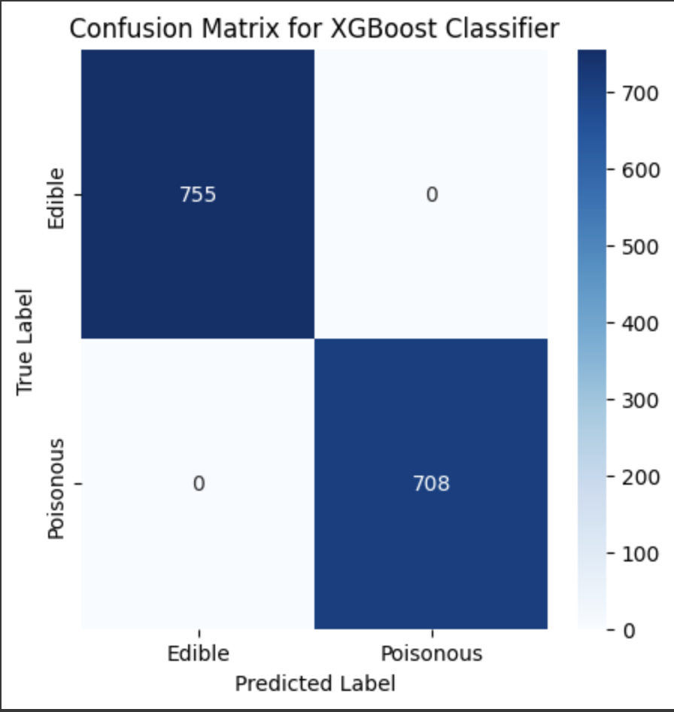
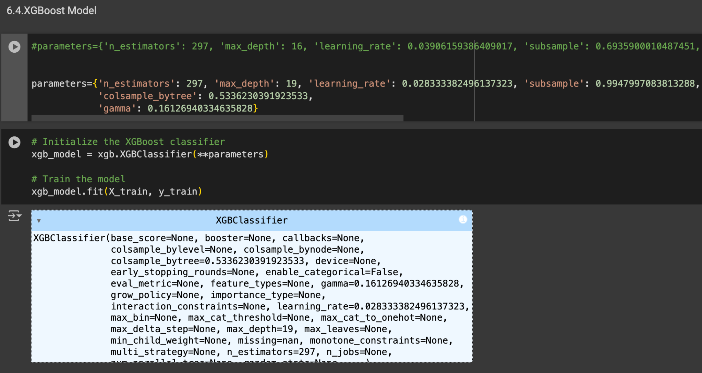
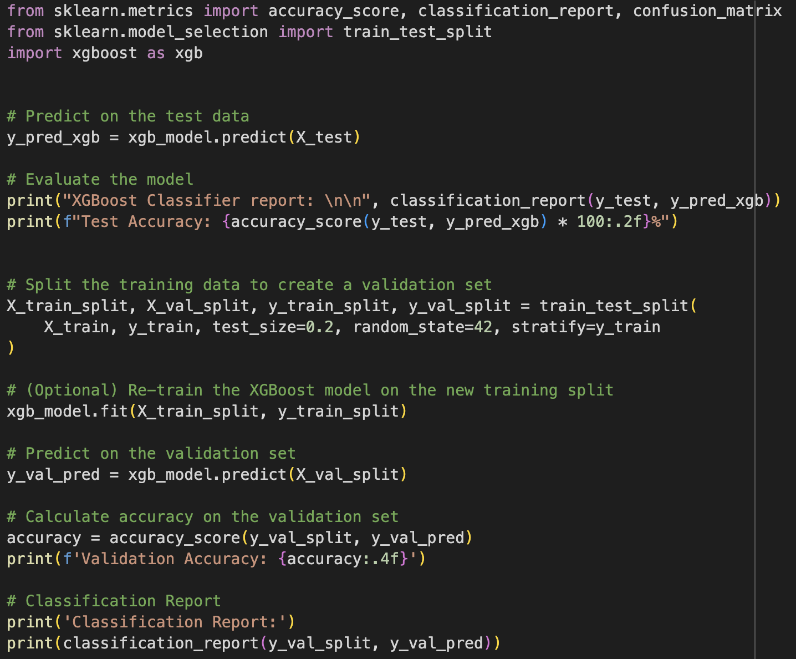
6.4. XGBoost

Slide 15
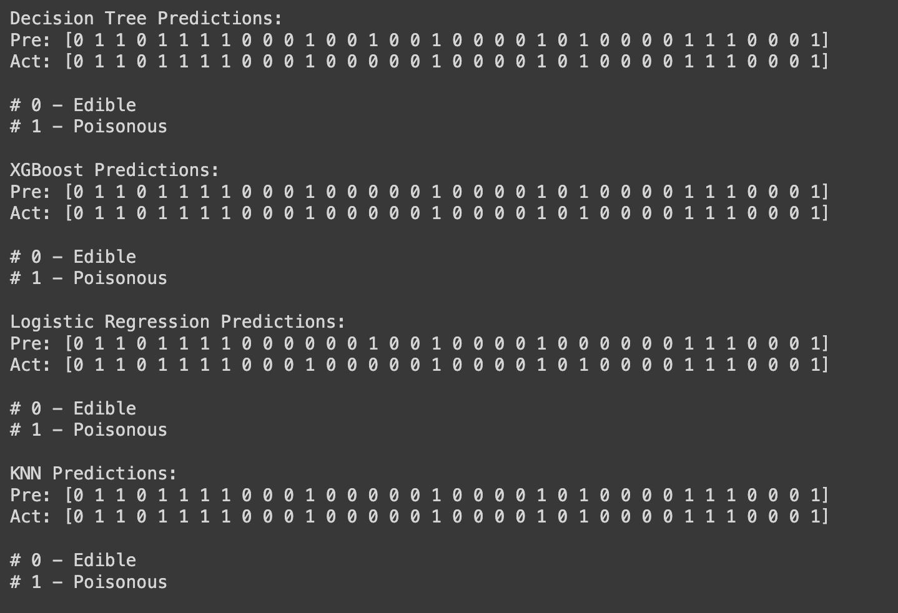

Conclusion
As technology continues to advance and more research is conducted, we can anticipate even greater strides in the accuracy and efficiency of mushroom classification using machine learning. This, in turn, will contribute to safer mushroom foraging practices, greater understanding of fungal biodiversity, and the preservation of ecosystems.
Now, we can eat Mushroom!

